Slide 1
CSS Animations
CSS allows animation of HTML elements without using JavaScript or Flash!
An animation lets an element gradually change from one style to another.
You can change as many CSS properties you want, as many times as you want.
To use CSS animation, you must first specify some keyframes for the animation.
Keyframes hold what styles the element will have at certain times.

Slide 2
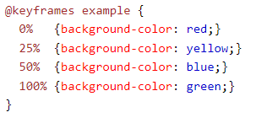

The @keyframes Rule
When you specify CSS styles inside the @keyframes rule, the animation will gradually change from the current style to the new style at certain times.
To get an animation to work, you must bind the animation to an element.

Slide 3
animation-name : Specifies the name of the @keyframes animation
animation-duration : defines how long an animation should take to complete.
animation-delay specifies a delay for the start of an animation.(can be negative)
animation-iteration-count : specifies the number of times an animation should run. (can be infinite)

Slide 4
animation-direction : specifies whether an animation should be played forwards, backwards or in alternate cycles
  Normal
  Reverse
  Alternate
  alternate-reverse

Slide 5
animation-timing-function : specifies the speed curve of the animation
  Ease
  Linear
  Ease-in
  Ease-out
  Ease-in-out

Slide 6

animation shorthand :

Slide 7
CSS Combinators
A CSS selector can contain more than one simple selector. Between the simple selectors, we can include a combinator
  descendant selector (space)
  child selector (>)
  adjacent sibling selector (+)
  general sibling selector (~)

Slide 8
Descendant selector matches all elements that are descendants of a specified element.
example
Child selector selects all elements that are the children of a specified element.
example

Slide 9
Adjacent sibling selector is used to select an element that is directly after another specific element.
example
General sibling selector selects all elements that are next siblings of a specified element.
Example

Slide 10
CSS Reset
The browser has its own styles applied by default in case the CSS doesn't load. These styles need to set back to zero by using a CSS reset
It can done by using universal selector (*)
* { margin: 0; padding: 0; border: 0; outline: 0; font-size: 100%; vertical-align: baseline; background: transparent; }.

Slide 11
CSS Units
Px vs %
% - Relative to the parent element
px - relative to the viewing device
Example

Slide 12
vh and vw
Viewport Height (vh). This unit is based on the height of the viewport. A value of 1vh is equal to 1% of the viewport height.
Viewport Width (vw). This unit is based on the width of the viewport. A value of 1vw is equal to 1% of the viewport width.
Example

Slide 13
em and rem
Em - unit that allows setting the font-size of an element relative to the font-size of its parent.
rem - unit that’ll always be based upon the font-size value of the root element, which is the <html> element. And if the <html> element doesn’t have a specified font-size, the browser default of 16px is used.
Example

Slide 14
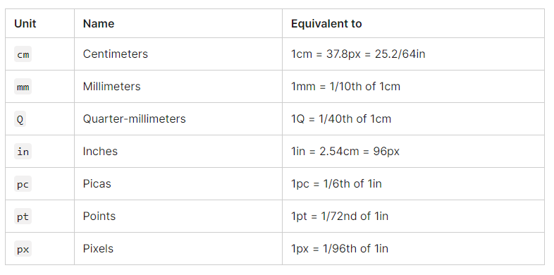
Absolute length units

Slide 15
CSS Media Queries
Media queries are useful when you want to modify your site or app depending on a device's general type (such as print vs. screen) or specific characteristics and parameters (such as screen resolution or browser viewport width)
.
all - works for all devices
print - works for devices where the media is in print preview mode
screen - works for devices with screens
speech - works for devices like screen readers where the content is read out loud to the user

Slide 16
Media queries can be used to check many things, such as:
width and height of the viewport
width and height of the device
orientation (is the tablet/phone in landscape or portrait mode?)
Resolution
Example

